Slide 1




ATDD
Web Test Automation
DEV3LSOLUTIONS.COM
LEANDOG.COM

Slide 2


Justin Beall
15 Years Software Engineering
CSM, A-CSD, CSPO, SA
Favorite language, Python
Notes:
2m : 2m

Slide 3
INTRODUCTIONS
Notes:
18m : 20m
Who are we?
Learning environment, feel free to ask questions.
What is everyone’s familiarity with the stack / software development.
Breakout rooms
Regular breaks – shoot for 10 till the hour, leaves room for questions and catch up as necessary

Slide 4

Why Are We Here?
Notes:
10m : 30m
How are releases performed currently?
Value Stream Map - where would the wait be?
What is testing at a higher level?
-- war stories

Slide 5

Course Objectives
Recognize Available ATDD Tools
Identify Gherkin Syntax
Practice with Automation Exercises
Integrate ATDD Into Daily Work
Notes:
5m : 35m

Slide 6

ATDD
Notes:
10m : 45m
Right to left perspective
ATDD is the consistent delivery of solutions that our customers love that fit the needs of the business
Unicorns

Slide 7
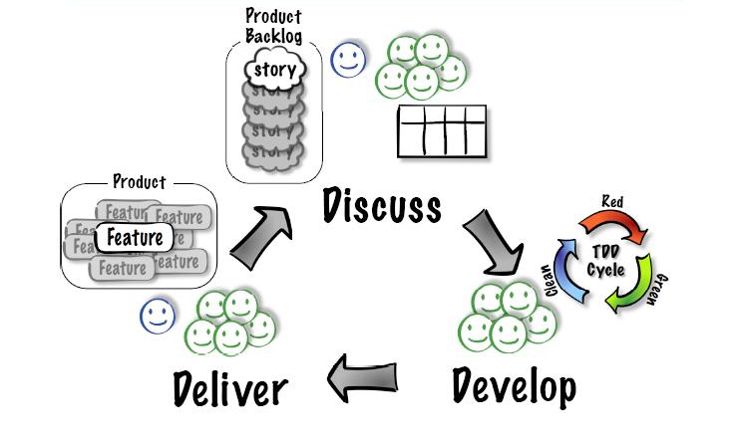
WHAT IS ATDD?
Notes:
15m : 60m
Acceptance Test Driven Development (ATDD) involves team members with different perspectives (customer, development, testing) collaborating to write acceptance tests in advance of implementing the corresponding functionality.
Despite the focus of this class, ATDD is much bigger and it’s major value prop is about the collaboration and definition of acceptance criteria with the automation being an added benefit.
Flow of ATDD
Discuss the highest priority story with Business, Design, Development and other stakeholder representation. (This is often referred as a 3 amigos meeting)
Out of this conversation the team will produce acceptance criteria in a simple, English like format called Gherkin (more on this later)
The team might also realize that this story is too big and needs to be split into multiple cards.
The team (most of the time developers and qa engineers) will take the Gherkin and then begin automating the tests and building the feature to satisfy the the acceptance test and unit tests (assuming TDD practices are being followed)
Once the team has satisfied all of the scenarios and steps outlined in the 3 amigos meeting (step 1), they will deliver the feature and do a show and tell.
Assuming the entire team, including the PO agrees that all acceptance criteria has been satisfied, the team pulls a new story and starts the cycle again.
Gherkin is used as a communication tool that leverages simple language and steps to ensure all team members are talking about the same thing and have the same understanding of the definition of done.

Slide 8

BREAK
Notes:
10m : 70m

Slide 9
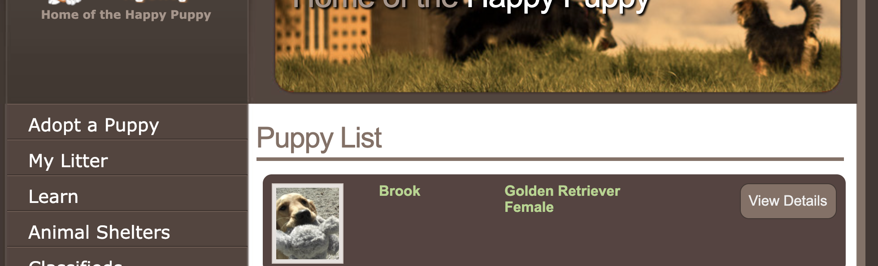
GHERKIN
Scenario: View the details of a puppy
Given I am on the home page
When I click on the puppy "Brook"
Then I see "Adopt Me!"
Notes:
10m : 80m
What is Gherkin?
Timebox this exercise for 10 minutes
Given / When / Then
Given – These steps are used to set up the initial state before you do your test
When – These steps are the actual test that is to be executed
Then – These steps are used to assert on the outcome of the test
Arrange / Act / Do
Make a peanut butter jelly?
Describe part of the product you are working on?

Slide 10
RUNNING TESTS
Manually
Local Automation
CI Build
00_hello_world
Notes:
15m : 95m
Make sure everyone has computer configured and runnable.
If we run into problems, pair up and resolve the problems at lunch time.
Review TypeScript quickly.
Walk before you run.
How can we get started?
Make sure everyone can run TypeScript

Slide 11

WHERE DOES AUTOMATION
FIT INTO ATDD?
Notes:
5m : 100m
How often should tests be ran?

Slide 12
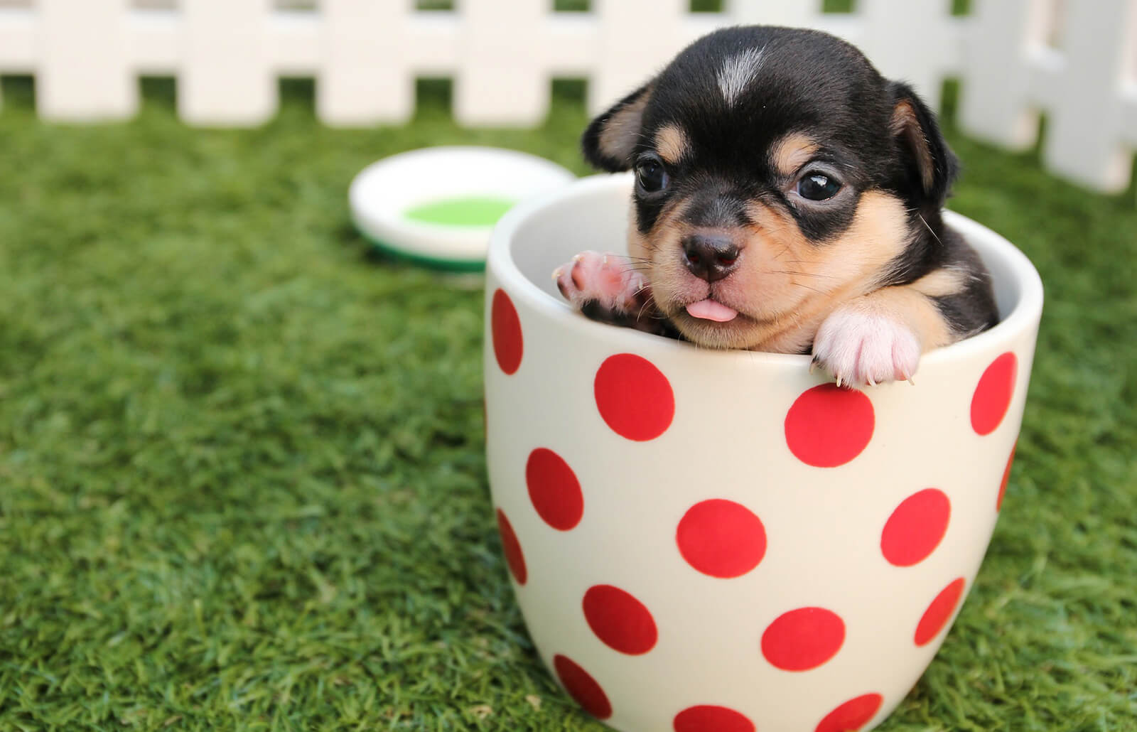
WHY USE AUTOMATION?
Repeatability / Idempotent
Computer does the work
Increases capacity
Reduced feedback and cycle time
Notes:
10m : 110m

Slide 13
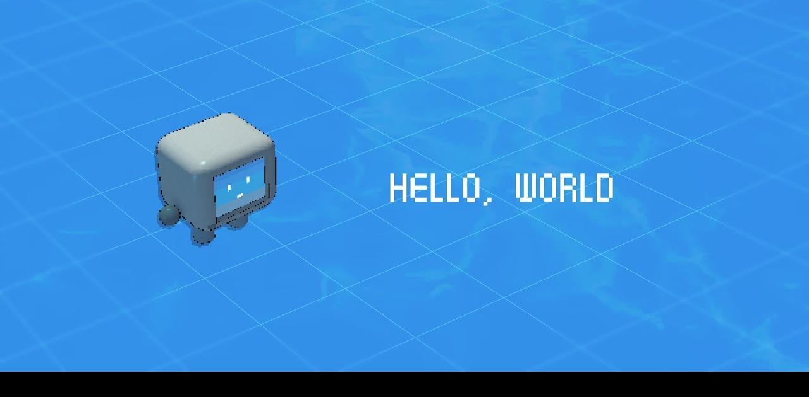
01_hello_world
Notes:
20m : 130m
Timebox this exercise for 15 minutes – Tour the hello world project
Make sure everyone has computer configured and runnable.
If we run into problems, pair up and resolve the problems at lunch time.
Make sure all can interactive debug a break point

Slide 14

BREAK
Notes:
10m : 140m

Slide 15
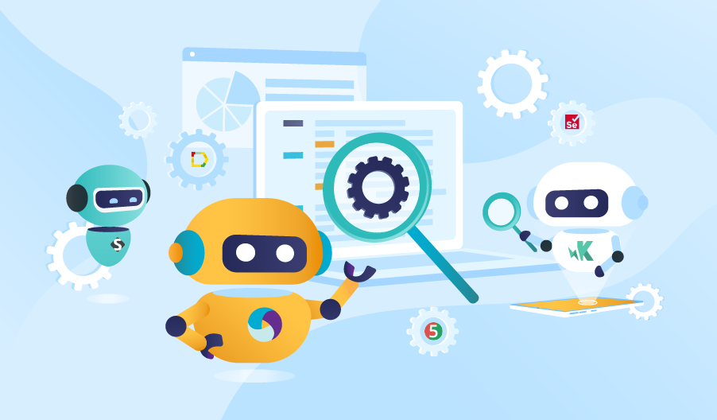
WEB TEST AUTOMATION TOOLS
GIVEN -> WHEN -> THEN PARSERS
Notes:
5m : 145m
Does anyone have familiarity with any automation tooling?

Slide 16

Cucumber JS
JavaScript-based implementation of Gherkin parser
Support for TypeScript
Integrates with Visual Studio Code
Notes:
5m : 150m

Slide 17
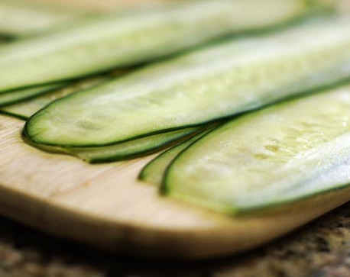
Cucumber.rb
Ruby-based
Original tool designed for parsing Given/When/Then tests (Gherkin)
Supported by RubyMine to write scenarios & run tests
Notes:
5m : 150m

Slide 18
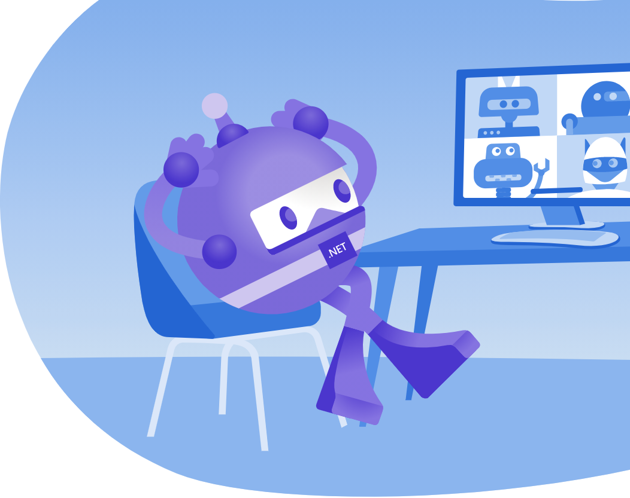
SpecFlow
Supports .NET, Xamarin and Mono
Uses official Given/When/Then Gherkin parser
Integrates with Visual Studio
Supports MSTest, NUnit, xUnit 2, and MbUnit
Notes:
5m : 150m

Slide 19

Cucumber JVM
Java-based implementation of Gherkin parser
Supports most of the popular languages for the JVM
Can integrate with Dependency Injection containers
Notes:
5m : 150m

Slide 20

Behave
Python-based implementation of Gherkin parser
Very similar usage to Ruby’s Cucumber
Notes:
5m : 150m

Slide 21

WEB TEST AUTOMATION TOOLS
BROWSER AUTOMATION
Notes:
5m : 155m

Slide 22

SELENIUM
First of second-generation Browser automation tools
Can drive browsers using many different languages - C#, Python, Ruby, Perl, PHP, & JavaScript
Now leverages the WebDriver API
Notes:
2.5m : 157.5m
Not the same as the Selenium IDE Record-Playback tool

Slide 23

PROTRACTOR
End-to-end behavior-driven testing framework
Designed keeping Angular JS applications in mind
Combining powerful technologies such as Jasmine, Selenium Webdriver, Node.js
Notes:
2.5m : 160m
What is Protractor?
The Protractor is an automation testing tool for web applications testing; combining powerful technologies such as Jasmine, Selenium Webdriver, Node.js etc.
The Protractor testing tool is an end to end behavior-driven testing framework designed keeping Angular JS applications in mind. Even though that might sound like Protractor won’t work with non-angular JS applications, it does.
It works with both Angular and non-Angular JS applications equally well.

Slide 24

WATIR
Web Application Testing in Ruby
Originally automated IE through COM
Later updated to use web drivers like Selenium under the hood in 2009
Automates Internet Explorer, Firefox and Chrome (using Chrome Driver)
Notes:
2.5m : 160m
cliec was the first tool (that I’m aware of) for automating a browser from a general-purpose programming language. cliec led to WTR which led to WATiR. Originally WATiR only worked with IE but had ports to later projects. In 2009 WATiR was ported to the WebDriver spec and began using tools like Selenium instead of driving browsers directly. Selenium was inspired by WATiR and was the first cross platform browser automation tool.

Slide 25

Puppies Scenario
02_puppies puppies.feature
Notes:
20m : 180m
Timebox this exercise for 20 minutes
Presenter goes through the 1st adopt_puppies.feature scenario with the class. The class is your “pair.” Timebox this exercise for 15 minutes Scenario: #1 Be able to view the details of a puppy
Given I am on the home page
When I click on the puppy "Brook"
Then I see "Adopt Me!”
POSSIBLE SOLUTION:
import { $, element, by, ElementFinder, browser } from 'protractor';
import { Given, When, Then } from 'cucumber';
const chai = require('chai').use(require('chai-as-promised'));
const expect = chai.expect;
Given(/^I am on the home page$/, async () => {
let expectedTitle = "Sally's Puppy Adoption Agency";
await browser.get('http://localhost:3000');
await expect(browser.getTitle()).to.eventually.equal(expectedTitle);
});
When(/^I click on the puppy "(.*?)"$/, async (puppyName) => {
let puppyList = await element.all(by.className('puppy_list'));
var puppy: ElementFinder;
for (let index in puppyList) {
let puppyElement = puppyList[index];
let rowText = await puppyElement.getText();
if (rowText.includes(puppyName)) {
puppy = puppyElement;
break;
}
}
let viewDetails = await puppy.element(by.className('rounded_button'));
await viewDetails.click();
});
Then(/^I see "(.*?)"$/, async (text) => {
let buttons = await element.all(by.className('rounded_button'));
let isFound = false;
for (let index in buttons) {
let button = buttons[index];
let rowText = await button.getAttribute('value');
if (rowText.includes(text)) {
isFound = true;
break;
}
}
expect(isFound).to.be.true;
});

Slide 26

PROJECT STRUCTURE
Notes:
20m : 200m
Explain here why we have the folder structure in the project:
features - main folder containing the gherkin “feature” files that have scenarios defined within them
step_definitions - contains the Ruby code that is executed based on the gherkin scenarios, this is the “bridge” between the gherkin and executable code
support - has the global environment and helper files generated by Cucumber. Any additional helper files (hooks, etc) are usually kept here.
This is the minimum structure, devs can further organize their files & features within these folders.

Slide 27

BREAK
Notes:
10m : 210m

Slide 28
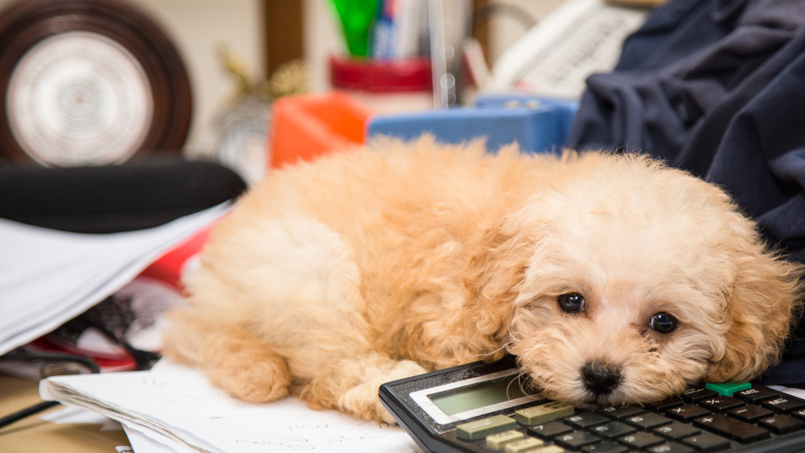
NEXT TWO SCENARIOS
03_puppies puppies.feature Scenarios #2 & #3
Notes:
30m : 240m
Class goes through 2nd & 3rd adopt_puppies.feature scenarios. Presenter is available for questions. Timebox this exercise for 30 minutes (15 per scenario)
Scenario: #2 Be able to return to the view of all available puppies
Given I am on the home page
When I click on the puppy "Brook"
And I click on "Return to List"
Then I see the home page
Scenario: #3 Be able to add the puppy to adopt later
Given I am on the home page
When I click on the puppy "Brook"
And I click on "Adopt Me!"
Then I see the puppy "Brook" is in my litter

Slide 29

Review
Notes:
10m : 250m
What went well?
What didn’t go well?
puppies.feature. Timebox this exercise for 15 minutes
POSSIBLE SOLUTION:
When(/^I click on "([^"]*)"$/) do |caption|
element = @browser.links(text: caption)[0]
element = @browser.buttons(text: caption)[0] unless element.exist?
element.click
end
Then(/^I see the puppy "([^"]*)" is in my litter$/) do |name|
expect(@browser.h2(text: "#{name}:").exist?).to be true
end

Slide 30
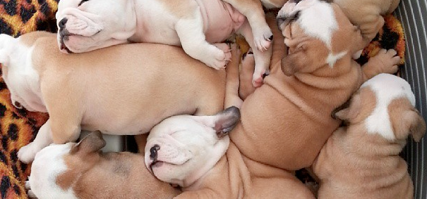
COMPOUND STEP SCENARIO
04_compound puppies.feature
Notes:
20m : 270m
In Cucumber-JVM calling steps from step definitions is not supported; this is by design.
The best way to achieve composition and reuse, is to use the features of your programming language. If you want to combine several actions into one step, extract individual (helper) methods and call these methods from your step definition.
You want to strive to keep your steps atomic as much as possible.
Presenter goes through the 4th adopt_puppies.feature scenario with the class. Timebox this exercise for 15 minutes
Scenario has a Given that rolls up a few previous Given steps
Scenario: #4 Be able to change my mind about adopting a puppy
Given I have added a puppy to my litter
When I click on "Change your mind"
Then I see the home page
POSSIBLE SOLUTION
Given(/^I have added a puppy to my litter$/) do step 'I am on the home page' step 'I click on the puppy "Brook"' step 'I click on "Adopt Me!"' end

Slide 31

BREAK
Notes:
10m : 280m

Slide 32

NEXT TWO SCENARIOS
05_compound puppies.feature Scenarios #5 & #6
Notes:
30m : 310m
Class goes through 5th & 6th puppies.feature scenarios.
Presenter is available for questions.
Timebox this exercise for 30 minutes
@Scenario
Scenario: Add another puppy to my litter
Given I have added the puppy "Brook" to my litter
When I click on "Adopt Another Puppy" in litter
And I click on the puppy "Ruby Sue"
And I click on "Adopt Me!"
Then I see the puppy "Ruby Sue" is in my litter
@Scenario
Scenario: Change my mind removes all puppies from my litter
Given I have added the puppy "Brook" to my litter
And I click on "Adopt Another Puppy"
And I click on the puppy "Ruby Sue"
And I click on "Adopt Me!"
When I click on "Change Your Mind" in litter
Then I return to the home page
And I see "Your cart is currently empty"

Slide 33

LET’S REVIEW!
Notes:
15m : 325m
Presenter reviews solution(s) to scenarios 5-6 of adopt_puppies.feature. Timebox this exercise for 15 minutes
POSSIBLE SOLUTION:
Given(/^I have added a puppy to my litter$/) do
step 'I am on the home page'
step 'I click on the puppy "Brook"'
step 'I click on "Adopt Me!"'
end

Slide 34
WALKTHROUGH A
CALCULATED ELEMENT SCENARIO
Notes:
15m : 340m
Presenter goes through the 7th adopt_puppies.feature scenario with the class. Timebox this exercise for 30 minutes
Assumption is the dog used in the scenario is Brook.
Scenario: #7 Add accessories to a puppy and the price change is reflected
Given I have added a puppy to my litter
When I add a “Collar & Leash” to my order
And I add a “Chew Toy” to my order
Then I see "$63.93"
POSSIBLE SOLUTION:
When(/^I add a "([^"]*)" to my order$/) do |accessory|
accessories = {"Collar & Leash"=> "collar", "Chew Toy" => "toy"}
@browser.checkbox(id: accessories[accessory]).set(true)
end

Slide 35

BREAK
Notes:
10m : 350m

Slide 36
TAGS, THE COMMAND LINE, AND OTHER SUNDRIES
Notes:
5m : 355m
Presenter discusses how tags work, how we can include/exclude features & scenarios from test runs with tags, and how to set up tags in Rubymine. Estimated length of this exercise is 30 minutes

Slide 37
TAGS
Tags are prepended with @ sign
Examples: @important @ignore
Can be used to define special behavior in tests
Can be used for test in/exclusion
Notes:
2.5m : 357.5m

Slide 38
USAGE OF TAGS
@ignore
Scenario: See the details of a puppy
Given I am on the home page
When I click on the puppy "Brooke"
Then I see "Adopt Me!"
Notes:
2.5m : 360m
Can put before a Feature or Scenario

Slide 39
TAGS & HOOKS
Before('@javascript') do # This will only run before
# scenarios tagged # with @javascript. end
Notes:
2.5m : 362.5m
Can also AND or OR hooks together
Works for all types of Hooks: Before, After, AfterStep, Around
For OR tags, pass the tags in a single string comma separated:
Before('@cucumis, @sativus') do # This will only run before scenarios tagged # with @cucumis OR @sativus. end
For AND tags, pass the tags as separate tag strings:
Before('@cucumis', '~@sativus') do # This will only run before scenarios tagged # with @cucumis AND NOT @sativus. end
You create complex tag conditions using both OR and AND on tags:
Before('@cucumis, @sativus', '@aqua') do # This will only run before scenarios tagged # with (@cucumis OR @sativus) AND @aqua end

Slide 40
TAGS & COMMAND LINE
cucumber --tags @wip
Run only items tagged with @wip
cucumber --tags ‘not @wip’
Run all items NOT tagged with @wip
Notes:
2.5m : 365m
Tags can also be defined as part of a cucumber.yml file in a project. We do have an example of this file in the atdd-with-puppies project that can be shown to participants.
Can also add multiple tags include/exclude to command line call.

Slide 41
PROFILES
Profiles are preconfigured switches for Cucumber
Profiles can be default, or named
Allows you to preset formatting, fast fail, etc
Stored in cucumber.yml file
Notes:
2.5m : 367.5m

Slide 42
PROFILES & COMMAND LINE
cucumber
Run all items NOT tagged with @wip, @javascript, @not_ready, @ignore
cucumber -p wip
Run ONLY items tagged with @wip
Notes:
2.5m : 370m
Tags can also be defined as part of a cucumber.yml file in a project. We do have an example of this file in the atdd-with-puppies project that can be shown to participants.
Can also add multiple tags include/exclude to command line call.

Slide 43
TAGS & PROFILES WRAPUP
Super useful for development flow to only run test(s) you are focusing on
You can implement Scenario #7 like I did… or put an @ignore tag above Scenario #7
Notes:
2.5m : 370m

Slide 44
DAY 1 - WRAP UP!

Slide 45


Slide 46
WALKTHROUGH A SCENARIO
THAT USES A DATA TABLE
Notes:
Presenter goes through the 2nd contact.feature scenarios with the class (skip first because it will be refactored into a Background later). Timebox this exercise for 15 minutes.
Scenario requires a data table to plug entries into a form.
Scenario: #2 Submit a message
Given I am on the home page
When I click on the email icon
And I fill the form in with the following values:
| element | value |
| contact_message_name | Joe Sixpack |
| contact_message_email | joe@sixpack.com |
| contact_message_body | I am having trouble adopting a puppy. Please help! |
And I click on "Send"
Then I see "Thank you for contacting us!"
SOLUTION:
When(/^I click on the email icon$/) do @browser.link(name: "contact").click end
When(/^I fill the form in with the following values:$/) do |table| table.hashes.each do |data| selector = {id: data['element']} value = data['value'] set_field(selector, value) end end
def set_field(selector, value)
@browser.element(selector).wait_until_present
if @browser.text_field(selector).exists?
@browser.text_field(selector).set(value)
elsif @browser.textarea(selector).exists?
@browser.textarea(selector).set(value)
else
@browser.select_list(selector).select_value(value)
end
end

Slide 47
NOW YOU DO THE NEXT SCENARIO
(adopt_puppies.feature Scenario #8)
Notes:
Class goes through 8th adopt_puppies.feature scenario. Presenter is available for questions. Timebox this exercise for 30 minutes
Scenario: #8 Complete an adoption
Given I have added a puppy to my litter
When I click on "Complete the Adoption"
And I fill the form in with the following values:
| element | value |
| order_name | Joe Sixpack |
| order_address | 123 Main St. |
| order_email | joe@sixpack.com |
| order_pay_type | Check |
And I click on "Place Order"
Then I see "Thank you for adopting a puppy!"

Slide 48
LET’S REVIEW!
Notes:
Presenter reviews solution(s) to scenario 8 of adopt_puppies.feature. Timebox this exercise for 15 minutes
POSSIBLE SOLUTION:
When(/^I fill the form in with the following values:$/) do |table| table.hashes.each do |data| selector = {id: data['element']} value = data['value'] set_field(selector, value) end end
def set_field(selector, value)
@browser.element(selector).wait_until_present
if @browser.text_field(selector).exists?
@browser.text_field(selector).set(value)
elsif @browser.textarea(selector).exists?
@browser.textarea(selector).set(value)
else
@browser.select_list(selector).select_value(value)
end
end

Slide 49

DAY 2
(BAMBOO FLOORING IS 1762 ON THE JANKA HARDNESS SCALE)

Slide 50
RECAP

Slide 51
WALKTHROUGH A SCENARIO
THAT USES AN OUTLINE
Notes:
Presenter goes through the 3rd contact.feature scenarios with the class. Timebox this exercise for 15 minutes.
Scenario requires an outline to plug entries into a form.
Scenario Outline: #3 All fields are required to send a message to the agency
Given I am on the home page
When I click on the email icon
And the contact form is completely filled in
But I blank out "<element>"
And I click on "Send"
Then I see "<error>"
Examples:
| element | error |
| contact_message_name | Name can't be blank |
| contact_message_email | Email can't be blank |
| contact_message_body | Body can't be blank |
POSSIBLE SOLUTION:
When(/^the contact form is completely filled in$/) do steps %Q{ And I fill the form in with the following values: | element | value | | contact_message_name | Name can't be blank | | contact_message_email | Email can't be blank | | contact_message_body | Body can't be blank | } end When(/^I blank out "(.*)"$/) do |element| set_field({id:element}, '') end

Slide 52
NOW YOU DO THE NEXT SCENARIO
(adopt_puppies.feature Scenario #9)
Notes:
Class goes through 9th adopt_puppies.feature scenario. Presenter is available for questions. Timebox this exercise for 30 minutes
Scenario Outline: #9 All fields are required to complete an adoption
Given I have added a puppy to my litter
When I click on "Complete the Adoption"
And the order form is completely filled in
But I blank out "<element>"
And I click on "Place Order"
Then I see "<error>"
Examples:
| element | error |
| order_name | Name can't be blank |
| order_address | Address can't be blank |
| order_email | Email can't be blank |
| order_pay_type | Pay type can't be blank |

Slide 53
LET’S REVIEW!
Notes:
Presenter reviews solution(s) to scenario 9 of adopt_puppies.feature. Timebox this exercise for 15 minutes
POSSIBLE SOLUTION:
When(/^the order form is completely filled in$/) do steps %Q{ And I fill the form in with the following values: | element | value | | order_name | Joe Sixpack | | order_address | 123 Main St. | | order_email | joe@sixpack.com | | order_pay_type | Check | } end When(/^I leave (.*) blank$/) do |element| set_field({id:element}, '') end

Slide 54
WALKTHROUGH A SCENARIO
THAT USES A BACKGROUND
Notes:
Presenter goes through the 1st contact.feature scenario with the class, refactoring the first 2 steps into a Background. Timebox this exercise for 15 minutes.
Background runs before every scenario, but after any Before hooks.
Remove the @ignore tag from Scenario #1
Move first 2 steps into a Background
Background:
Given I am on the home page
When I tap on the email icon
Remove those steps from Scenario #1
Scenario: #1 Get to the contact form
Then I see the heading "Contact"
Implement new step definition in Scenario #1
Remove the same 2 steps from Scenarios #2 & #3
Rerun all scenarios in the feature file to show how this all works
Scenario: #2 Submit a message
Given I am on the home page
When I click on the email icon
And I fill the form in with the following values:
| element | value |
| contact_message_name | Joe Sixpack |
| contact_message_email | joe@sixpack.com |
| contact_message_body | I am having trouble adopting a puppy. Please help! |
And I click on "Send"
Then I see "Thank you for contacting us!"
Scenario Outline: #3 All fields are required to send a message to the agency
Given I am on the home page
When I click on the email icon
And the contact form is completely filled in
But I blank out "<element>"
And I click on "Send"
Then I see "<error>"
Examples:
| element | error |
| contact_message_name | Name can't be blank |
| contact_message_email | Email can't be blank |
| contact_message_body | Body can't be blank |

Slide 55
NOW YOU DO THE NEXT SCENARIO
Notes:
Class goes through 1st discussion_board.feature scenario. Presenter is available for questions. Timebox this exercise for 15 minutes
Participants have to implement the Then I see the heading "Message Boards" step
Background:
Given I am on the home page
And I click on "Message Boards"
Scenario: #1 Can access the Message Boards
Then I see the heading "Message Boards"

Slide 56
LET’S REVIEW!
Notes:
Presenter reviews solution(s) to 1st discussion_board.feature scenario. Timebox this exercise for 15 minutes
POSSIBLE SOLUTION:
Then(/^I see the heading "([^"]*)"$/) do |text|
expect(@browser.div(id: 'content').h2().text.include?(text)).to be true
end

Slide 57
15 MIN BIO BREAK!

Slide 58
WHICH IS BETTER IN STEP DEFINITIONS?
@browser.text_field(id:’username’).text = ‘joe@sixpack.com’ @browser.text_field(id:’password’).text = ‘P@ssw0rd1!’ @browser.input(id:’submit’).click
OR
loginPage.login_with(‘joe@sixpack.com’, ‘P@ssw0rd1!’)

Slide 59
PAGEOBJECT PATTERN

Slide 60
PAGEOBJECT
Pattern that represents HTML pages as objects
Encapsulate functionality of a page
One place to change if HTML structure changes
Expose page functionality as services

Slide 61
PAGEOBJECT - SERVICES
Class properties could return strings for dynamic text in page, contents of tables, etc
Class methods allow you to take action on the page, and could return new PageObjects, booleans, etc.

Slide 62
PAGEOBJECT - SHARED SERVICES
Menus and other common controls can be modelled using modules or base classes

Slide 63
PAGEOBJECT - IMPLEMENTATIONS
Can build PageObjects with POROs
Ruby has a few gems that help you implement the pattern
page-object
site_prism
Notes:
PORO = Plain Old Ruby Object
page-object uses Watir powered by Selenium and web-driver
site_prism uses Capybara which also uses Selenium and web-driver

Slide 64
WALKTHROUGH IMPLEMENTING
AN EXAMPLE PAGEOBJECT
Notes:
Presenter goes through creating a PageObject class(es) with the class. Timebox this exercise for 30 minutes.
If time allows, refactor some steps from adopt_puppies.feature to use the new PageObject class.
Put the classes into a pages/ subdirectory in features/.
POSSIBLE RUBY CLASS SOLUTION:
module PuppiesMenu
def to_go_contact
@browser.link(name: "contact").click
end
def go_to_adopt_a_puppy
@browser.link(name: "adopt-a-puppy").click
end
def go_to_my_litter
@browser.link(name: "my-litter").click
end
def go_to_learning
@browser.link(name: "learn").click
end
def go_to_shelters
@browser.link(name: "animal-shelters").click
end
def go_to_classifieds
@browser.link(name: "classifieds").click
end
def go_to_discussions
@browser.link(name: "message-boards").click
end
def go_to_news
@browser.link(name: "pet-news").click
end
end
require_relative ‘puppies_menu’
class AgencyPage
include PuppiesMenu
def initialize(browser)
@browser = browser
end
def view_puppy(name)
puppies = @browser.divs(class: 'puppy_list')
puppies.img(alt: name).parent.parent.divs.last.button.click
end
end
require_relative ‘puppies_menu’
class PuppyPage
include PuppiesMenu
def initialize(browser)
@browser = browser
end
def adopt_puppy
@browser.buttons(text: 'Adopt Me!')[0]
end
def return_to_puppy_list
@browser.buttons(text: 'Return to List')[0]
end
end
require_relative ‘puppies_menu’
require ‘activesupport’
class MyLitterPage
include PuppiesMenu
def initialize(browser)
@browser = browser
end
def complete_the_adoption
@browser.buttons(text: 'Complete the Adoption')[0].click
end
def adopt_another_puppy
@browser.buttons(text: 'Adopt Another Puppy')[0].click
end
def change_your_mind
@browser.buttons(text: 'Change Your Mind')[0].click
end
def puppy_names
@browser.tables.collect { |div| div.id.sub('puppy-', '').titleize }
end
def select_additional_product(name)
accessories = {"Collar & Leash"=> "collar", "Chew Toy" => "toy", "Travel Carrier" => "carrier", "First Vet Visit" => "vet"}
raise "Product/Service not found" unless accessories.has_key?(name)
@browser.checkbox(id: accessories[name]).set(true)
end
end
POSSIBLE SCENARIO STEP DEFINITION SOLUTION:
Given(/^I am on the home page$/) do @browser.goto 'http://localhost:3000/' end
When(/^I click on the puppy "([^"]*)"$/) do |puppy_name| page = AgencyPage.new(@browser)
page.view_puppy(puppy_name) end Then(/^I see "([^"]*)"$/) do |expected_text| expect(@browser.html.include? expected_text).to be true end
When(/^I click on "([^"]*)"$/) do |caption| element = @browser.links(text: caption)[0] element = @browser.buttons(text: caption)[0] unless element.exist? element.click end Then(/^I see the home page$/) do expect(@browser.url).to eq 'http://localhost:3000/' end
Then(/^I see the puppy "([^"]*)" is in my litter$/) do |name|
page = MyLitter.new(@browser) expect(page.puppy_names.include?(name)).to be true end Given(/^I have added a puppy to my litter$/) do step 'I am on the home page' step 'I click on the I click on the puppy "Brooke”' step 'I click on "Adopt Me!"' end When(/^I add a "([^"]*)" to my order$/) do |accessory| page = MyLitter.new(@browser) page.select_additional_product(accessory) end def set_field(selector, value) if @browser.text_field(selector).exists? @browser.text_field(selector).set(value) elsif @browser.textarea(selector).exists? @browser.textarea(selector).set(value) else @browser.select_list(selector).select_value(value) end end And(/^I fill the form in with the following values:$/) do |table| table.hashes.each do |data| selector = {id: data['element']} value = data['value'] set_field(selector, value) end end And(/^the order form is completely filled in$/) do steps %Q{ And I fill the form in with the following values: | element | value | | order_name | Joe Sixpack | | order_address | 123 Main St. | | order_email | joe@sixpack.com | | order_pay_type | Check | } end And(/^I leave (.*) blank$/) do |element| set_field({id:element}, '') end When(/^I click on the email icon$/) do @browser.link(name: "Contact").click end

Slide 65
NOW YOU CREATE YOUR
OWN PAGEOBJECTS
(Just practice, don’t worry about Done)
Notes:
Class developers their own PageObjects to support the site in the adopt_puppies.feature. Presenter is available for questions. Timebox this exercise for 30 minutes
Participants don’t have to complete any conversions, it is mostly for them to try themselves, ask questions, and get some more hands-on with the pattern.

Slide 66
LET’S REVIEW!
Notes:
Presenter reviews solution(s) to PageObjects to support the site in the adopt_puppies.feature. Timebox this exercise for 15 minutes
POSSIBLE RUBY CLASS SOLUTION:
module PuppiesMenu
def to_go_contact
@browser.link(name: "contact").click
end
def go_to_adopt_a_puppy
@browser.link(name: "adopt-a-puppy").click
end
def go_to_my_litter
@browser.link(name: "my-litter").click
end
def go_to_learning
@browser.link(name: "learn").click
end
def go_to_shelters
@browser.link(name: "animal-shelters").click
end
def go_to_classifieds
@browser.link(name: "classifieds").click
end
def go_to_discussions
@browser.link(name: "message-boards").click
end
def go_to_news
@browser.link(name: "pet-news").click
end
end
class AgencyPage
include PuppiesMenu
def initialize(browser)
@browser = browser
end
def view_puppy(name)
puppies = @browser.divs(class: 'puppy_list')
puppies.img(alt: name).parent.parent.divs.last.button.click
end
end
class PuppyPage
include PuppiesMenu
def initialize(browser)
@browser = browser
end
def adopt_puppy
@browser.buttons(text: 'Adopt Me!')[0]
end
def return_to_puppy_list
@browser.buttons(text: 'Return to List')[0]
end
end
class MyLitterPage
include PuppiesMenu
def initialize(browser)
@browser = browser
end
def complete_the_adoption
@browser.buttons(text: 'Complete the Adoption')[0].click
end
def adopt_another_puppy
@browser.buttons(text: 'Adopt Another Puppy')[0].click
end
def change_your_mind
@browser.buttons(text: 'Change Your Mind')[0].click
end
def puppy_names
@browser.tables.collect { |div| div.id.sub('puppy-', '').titleize }
end
def select_additional_product(name)
accessories = {"Collar & Leash"=> "collar", "Chew Toy" => "toy", "Travel Carrier" => "carrier", "First Vet Visit" => "vet"}
raise "Product/Service not found" unless accessories.has_key?(name)
@browser.checkbox(id: accessories[name]).set(true)
end
end
POSSIBLE SCENARIO STEP DEFINITION SOLUTION:
Given(/^I am on the home page$/) do @browser.goto 'http://localhost:3000/' end
When(/^I click on the puppy "([^"]*)"$/) do |puppy_name| page = AgencyPage.new(@browser)
page.view_puppy(puppy_name) end Then(/^I see "([^"]*)"$/) do |expected_text| expect(@browser.html.include? expected_text).to be true end
When(/^I click on "([^"]*)"$/) do |caption| element = @browser.links(text: caption)[0] element = @browser.buttons(text: caption)[0] unless element.exist? element.click end Then(/^I see the home page$/) do expect(@browser.url).to eq 'http://localhost:3000/' end
Then(/^I see the puppy "([^"]*)" is in my litter$/) do |name|
page = MyLitter.new(@browser) expect(page.puppy_names.include?(name)).to be true end Given(/^I have added a puppy to my litter$/) do step 'I am on the home page' step 'I click on the I click on the puppy "Brooke”' step 'I click on "Adopt Me!"' end When(/^I add a "([^"]*)" to my order$/) do |accessory| page = MyLitter.new(@browser) page.select_additional_product(accessory) end def set_field(selector, value) if @browser.text_field(selector).exists? @browser.text_field(selector).set(value) elsif @browser.textarea(selector).exists? @browser.textarea(selector).set(value) else @browser.select_list(selector).select_value(value) end end And(/^I fill the form in with the following values:$/) do |table| table.hashes.each do |data| selector = {id: data['element']} value = data['value'] set_field(selector, value) end end And(/^the order form is completely filled in$/) do steps %Q{ And I fill the form in with the following values: | element | value | | order_name | Joe Sixpack | | order_address | 123 Main St. | | order_email | joe@sixpack.com | | order_pay_type | Check | } end And(/^I leave (.*) blank$/) do |element| set_field({id:element}, '') end When(/^I click on the email icon$/) do @browser.link(name: "Contact").click end

Slide 67
TEST FIXTURES, DATA MANAGEMENT,
AND OTHER SUNDRIES

Slide 68
HOW DO YOU MANAGE TEST DATA?
SQL scripts?
Backups?
Don’t do it at all?

Slide 69
DATA GENERATORS ARE A WAY...
DataMagic - provides datasets that can be used by your application and tests
HipTest - commercial app for test & test data management

Slide 70
LET’S DISCUSS!
This is a highly subjective and context aware topic.

Slide 71
15 MIN BIO BREAK!

Slide 72
WALKTHROUGH A SCENARIO
FOR AN AJAX PAGE
Notes:
Presenter goes through the 2nd discussion_board.feature scenario with the class. Timebox this exercise for 15 minutes.
The Discussion Board contains a form for new post that is dynamically injected into the DOM.
@data_purge
Scenario: #2 Create a new topic thread
When I click on "Post a Message"
And I fill the form in with the following values:
| element | value |
| discussion_post_nickname | goldeneye1942 |
| discussion_post_body | Goldens are the best! |
And I click on "Post"
Then I see a post with the message "Goldens are the best!"
POSSIBLE SOLUTION:
Then(/^I see the heading "([^"]*)"$/) do |text|
expect(@browser.h2(text: text).exist?).to be true
end
Then(/^I see a post with the message "([^"]*)"$/) do |expected_message|
@browser.h2(text: 'Message Boards').wait_until_present
sleep(1)
messages = @browser.divs(class: 'message-content').collect do |element|
element.div.html
end
expect(messages.any? { |s| s.include?(expected_message) }).to be true
end

Slide 73
NOW YOU DO THE NEXT SCENARIO
(discussion_board.feature Scenario #3)
Notes:
Class goes through 3rd discussion_board.feature scenario. Presenter is available for questions. Timebox this exercise for 15 minutes

Slide 74
LET’S REVIEW
Notes:
Presenter goes over the AJAX test scenario that the class. Timebox this exercise for 15 minutes
POSSIBLE SOLUTION:
Then(/^I see the heading "([^"]*)"$/) do |text|
expect(@browser.div(id: 'content').h2().text.include?(text)).to be true
end
Then(/^I see a post with the message "([^"]*)"$/) do |expected_message|
@browser.h2(text: 'Message Boards').wait_until_present
sleep(1)
messages = @browser.divs(class: 'message-content').collect do |element|
element.div.html
end
expect(messages.any? { |s| s.include?(expected_message) }).to be true
end
Given(/^I have an existing thread$/) do
steps %Q{
When I click on "Post a Message"
And I fill the form in with the following values:
| element | value |
| discussion_post_nickname | goldeneye1942 |
| discussion_post_body | Goldens are the best! |
And I click on "Post"
Then I see a post with the message "Goldens are the best!"
}
end

Slide 75
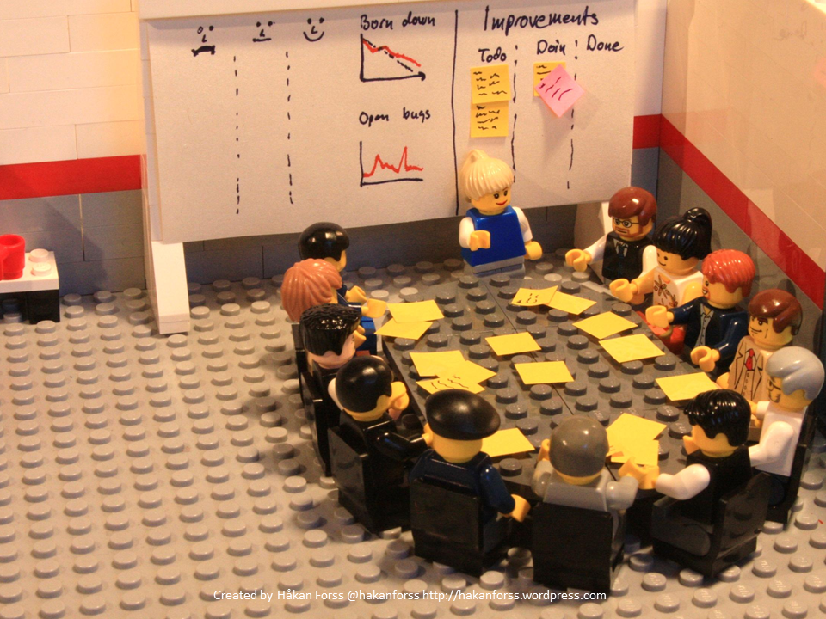
RETROSPECTIVE
Notes:
PORO = Plain Old Ruby Object

Slide 76


Slide 77
THE END
(THAT IS SOME GREAT LOOKING BAMBOO FLOORING!)

